Slide 1
Verilog Programming
Prepared By Darshan M R Application Engineer Ramaiah Skill Academy

Slide 2
contents
Introduction to Verilog
History
Design Flow
Definition of Module
Commenting in Verilog
Module interface
Different Modeling Styles
Data types, constants and parameters
Array
Memmory
Assignment
IF Statement
Case Statement
Module instance and instantiation
Task and function

Slide 3
Introduction to Verilog HDL
What is Verilog?
An HDL for designing digital systems.
IEEE 1364 Standardized Language.
Design Flow in Verilog:
Coding → Simulation → Synthesis → Implementation.

Slide 4
History:
Need: a simple, intuitive and effective way of describing digital circuits for modeling, simulation and analysis.
Developed in 1984-85 by Philip Moorby
In 1990 Cadence opened the language to the public
Standardization of language by IEEE in 1995

Slide 5
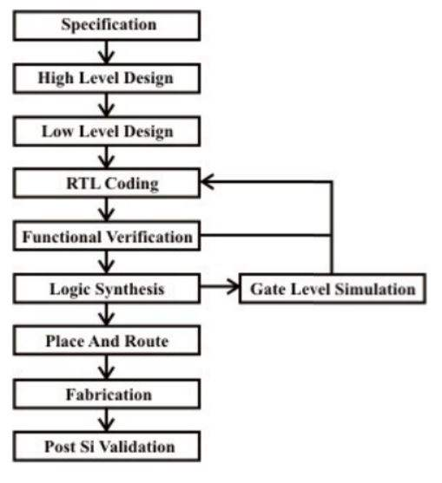
Design flow

Slide 6
Definition of Module
Interface: port and parameter declaration
Body: Internal part of module
Add-ons (optional) module(port list);
//port declaration;
//design body
//Add-ons
endmodule;

Slide 7
Commenting in verilog
The name of Module
Comments in Verilog
One line comment (// ………….)
Block Comment (/*…………….*/)
Description of Module (optional but suggested)

Slide 8
The Module Interface
a
b out
module adder(a,b,out);//port list
input a,b; // port declaration
assign out=a+b; //body
endmodule
Adder

Slide 9
Different modelling styles
Structural level model
Gate level
Data flow level model
Behavioral level model
Switch level

Slide 10
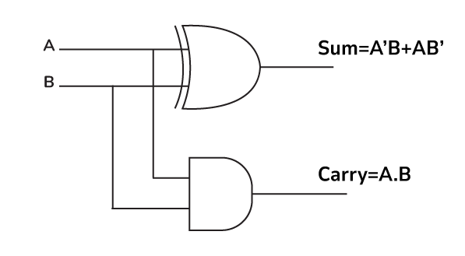
Half adder

Slide 11
Gate level model
module HalfAdder_GateLevel ( input A, // 1-bit input A
input B, // 1-bit input B
output SUM, // 1-bit sum output
output CARRY // 1-bit carry output );
xor (SUM, A, B); // XOR gate for sum
and (CARRY, A, B); // AND gate for carry
endmodule

Slide 12
Data flow model
module HalfAdder_Dataflow ( input A, // 1-bit input A
input B, // 1-bit input B
output SUM, // 1-bit sum output
output CARRY // 1-bit carry output );
assign SUM = A ^ B; // XOR for sum
assign CARRY = A & B; // AND for carry
endmodule

Slide 13
Behavioral model
module HalfAdder_Behavioral ( input A, // 1-bit input A
input B, // 1-bit input B
output reg SUM, // 1-bit sum output
output reg CARRY // 1-bit carry output );
always @(*) begin
SUM = A ^ B; // XOR for sum
CARRY = A & B; // AND for carry
end
endmodule

Slide 14
Data Types, Constants, Parameters
Data types:
Nets: physical connection between hardware elements
-> wire
Registers: Store value even if disconnected
-> reg
Constants: signed and unsigned
30 , -2
2’b10 , 6’d-4
Parameter:
parameter red=1;

Slide 15
Data types
Real :
delta=4e10; delta=2.34;
Vector:
wire [0:10]bus; reg [0:10]buffer;
Integer:
integer i=10;
Time :
$time;

Slide 16
Array
One dimensional array
reg data[0:10];
reg [7:0]data [0:10];
Multi dimensional array
reg data[0:10][0:10];

Slide 17
Memory
reg mem1bit[0:1023]; //1kb with 1bit
reg [7:0] mem8bit[0:1023]; //1k with 8bit

Slide 18
Assignment
Continuous Assignment
module continuous(input statin, output statout);
assign statout= ~statin;
endmodule
Procedural Assignment
Blocking
Non-Blocking

Slide 19
Blocking Assignment
Symbol: =
module blocking(input [0:2]preset ,
output reg [3:0] count)
always @(preset)
count=preset+1; //blocking procedural Assignment .
endmodule

Slide 20
Non-Blocking Assignment
Symbol: <=
module Nonblocking( input [3:0] regA,Mask,
output reg [3:0]regB);
always @( regA or Mask)
regB<=regA & Mask; //non-blocking assignment
endmodule

Slide 21
Operations
Arithmetic operations
Logical operations
Relational operations
Equality operations
Shift operations
Vector operstion
Part selector
Bit selector
Conditional expression

Slide 22
IF Statement
Module selectone(input a,b
output z);
always @( a or b)
if(a>b)
z=a;
else
z=b;
end

Slide 23
Case Statement
module alu(input a,b,
input [1:0]sel,
output out);
always @(a or b or sel)
begin
case(sel)
00:out=a+b;
01:out=a-b;
10:out=a&b;
11:out=a|b;
endcse
end
endmodule

Slide 24
Case Statement
Casex
module casex_example;
reg [3:0] input_val;
reg output_val;
always @(*) begin
casex (input_val)
4'b1xx0: output_val = 1'b1; // Matches any value where MSB is 1 and LSB is 0
4'b0x1x: output_val = 1'b0; // Matches any value where MSB is 0 and bit 2 is 1
default: output_val = 1'bx; // For all other cases
endcase
end
endmodule

Slide 25
Case Statement
Casez
module casez_example;
reg [3:0] input_val;
reg output_val;
always @(*) begin
casez (input_val)
4'b1z10: output_val = 1'b1; // Matches any value with MSB=1, second bit high-impedance (z)
4'b0z1z: output_val = 1'b0; // Matches any value with MSB=0, second and fourth bit high-impedance
default: output_val = 1'bx; // For all other cases
endcase
end
endmodule

Slide 26
Case statement
module two_variable_case_example;
reg [1:0] var1, var2; // Two variables
reg [3:0] combined_var; // Combined variable for case
reg output_val;
always @(*) begin
combined_var = {var1, var2}; // Concatenate var1 and var2
case (combined_var)
4'b0000: output_val = 1'b0; // var1=00, var2=00
4'b0001: output_val = 1'b1; // var1=00, var2=01
4'b0010: output_val = 1'b0; // var1=00, var2=10
4'b0011: output_val = 1'b1; // var1=00, var2=11
default: output_val = 1'bx; // Unmatched values
endcase
end
endmodule

Slide 27
Module instance & Instantiation
module TopModule;
reg [3:0] A, B; // 4-bit inputs
reg Cin; // Carry input
wire [3:0] Sum; // 4-bit Sum output
wire Cout; // Carry output
// Instantiate the Adder4Bit module
Adder4Bit myAdder (
.A(A), // Connect A
.B(B), // Connect B
.Cin(Cin), // Connect Cin
.Sum(Sum), // Connect Sum
.Cout(Cout) // Connect Cout
);
endmodule

Slide 28
Module instance & Instantiation
module Adder4Bit(
input [3:0] A, // 4-bit input A
input [3:0] B, // 4-bit input B
input Cin, // Carry input
output [3:0] Sum, // 4-bit Sum output
output Cout // Carry output
);
assign {Cout, Sum} = A + B + Cin; // Addition with carry
endmodule

Slide 29
Tasks and Functions
Functions in Verilog
A function that does not consume simulation time, returns a single value or an expression, and may or may not take arguments.
Keywords used: function and endfunction.

Slide 30
Function
//Method 1
function <ret_type> <func_name> (input <port_list>, inout <port_list>, output <port_list>);
...
return <val or expression>
endfunction
// Method 2
function <return_type> <func_name> ();
input <port_list>;
inout <port_list>;
output <port_list>;
...
return <val or exp>
endfunction

Slide 31
Function Example
module func;
function compare(input int val1,val2);
if(val1>val2)
$display(“val1 is greater than val2”);
else if(val1<val2)
$display(“val1 is less than val2”);
else
$display(“val1 is equal to val2”);
return 1; //not mandatory
endfunction
Initial begin
compare(10,10);
compare(5,9);
compare(9,5);
end
endmodule

Slide 32
Task
//method 1
task <task_name>(input <port_list>,output <port_list>);
…….
endtask
//method 2
task <task_name>();
input <port_list>;
output <port_list>;
…………………..
endtask

Slide 33
Task Example
module task_ex;
task compare(input int val1,val2, output done);
if(val1>val2)
$display(“val1 is greater than val2”);
else if(val1<val2)
$display(“val1 is less than val2”);
else
$display(“val1 is equal to val2”);
#20;
done = 1; //not mandatory
endtask
Initial begin
bit done;
compare(10,10,done);
if(done)$display(“comparison dine at time =%0t”,$time);
compare(5,9);
if(done)$display(“comparison dine at time =%0t”,$time);
compare(9,5);
if(done)$display(“comparison dine at time =%0t”,$time);
end
endmodule

Slide 34
Difference between Task & Function
Feature | Task | Function
Declaration | task, endtask | function, endfunction
Arguments | input, output, inout | input only
Timing Controls | Allowed (#, @, wait) | Not Allowed
Return Value | output, inout | Directly returns a value
Call Syntax | Procedural (task_name) | Expression (function_name)
Usage Context | Procedural only | Procedural and continuous

Slide 35
Reference
Verilog HDL Synthesis A practical primer by J Bhasker -BS Publications

